Slide 1

AIRBNB INSIGHTS: MULTI-REGRESSION ANALYSIS OF PRICE FACTORS IN TOP 10 TOURIST US STATES
Done by:
Harshan Ragavandar
Muhammad Miqdad
Priya Bhavana Dwaram
Srikar Varma Nadimpalli

Slide 2
Table of contents
01
02
03
Introduction
Data
Model
04
Conclusion

Slide 3
01
Introduction

Slide 4
Introduction
The pricing dynamics of short-term rental spaces, particularly through platforms like Airbnb, are intricate and influenced by a multitude of factors. To address this complexity, we conducted a comprehensive analysis focusing on Airbnb rental spaces across ten major cities in the United States.
Our study utilizes advanced data analysis techniques, including linear regression, to uncover the primary drivers behind pricing in these prominent tourist destinations. By leveraging a rich dataset comprising over 80 variables, ranging from fundamental factors like bedroom numbers to nuanced amenities, we identified key variables that significantly impact pricing while excluding less influential ones. This meticulous approach ensures our findings are relevant to a broad spectrum of rental space providers and consumers in high tourist influx areas.
Despite offering valuable insights into current market conditions, we recognize the inherent limitations of our model. Market dynamics can evolve rapidly, leading to pricing fluctuations beyond the scope of our analysis. Moreover, while our dataset covers the period from 2021 to 2023, capturing a period of relative economic stability post-COVID-19, ongoing technological advancements in the short-term rental sector necessitate a continual reassessment of pricing determinants. Thus, while our study provides a robust framework for understanding Airbnb pricing dynamics, ongoing monitoring and adaptation are essential in navigating the ever-evolving landscape of short-term rentals.

Slide 5
02
DATA

Slide 6
DATA COLLECTION
We gathered our data from "Inside Airbnb", a project with a clear mission to offer insights and advocacy regarding Airbnb's influence on residential areas. This platform serves as a reliable source, known for its accuracy in providing data. Through various stages and platforms, our data collection efforts culminated in sourcing our information from Inside Airbnb, ensuring a dependable and accurate dataset for our analysis.
VARIABLE SELECTION
Our data set is too huge. Each of our data point is explained by 85 different variables, so we decided to use subset of the initial data set. In this research we targeted on consumer values & micro-economic factors, variables those fit this criterion will be taken consideration while creating this subset. Variables was removed, based on domain knowledge.
We considered variables on 3 major factors:
Variables about the main physical factors of the accommodation.
Host profile and characteristics.
Amenities and general properties.

Slide 7
03
MODEL

Slide 8
HEDONIC PRICING
A hedonic pricing model uses a type of math called linear regression to guess how much something should cost based on what it's like.
This is often used in real estate to figure out what makes a house worth a certain amount of money. The math looks at all the different things about the house, like how big it is or where it's located, and decides how much each of those things should affect the price.
There are different ways to do this math, some more complicated than others, but for this study, we're sticking to the simpler linear method.

Slide 9
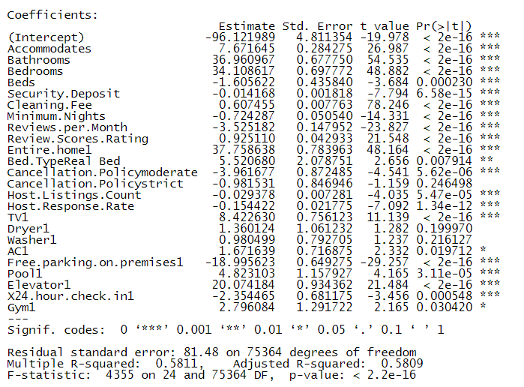
MODEL DEVELOPMENT
Initial Model
In the initial model, we have 34 variables which are categorical and quantitative. With the initial model, we have a few variables that are not significant even though which has causality.
With further modeling, we will remove the variables that are not significant and build a model where all the independent variables are significant.
For this model, we have an Adjusted R-square of 0.5809 and a P-value of 2.2e-16.

Slide 10
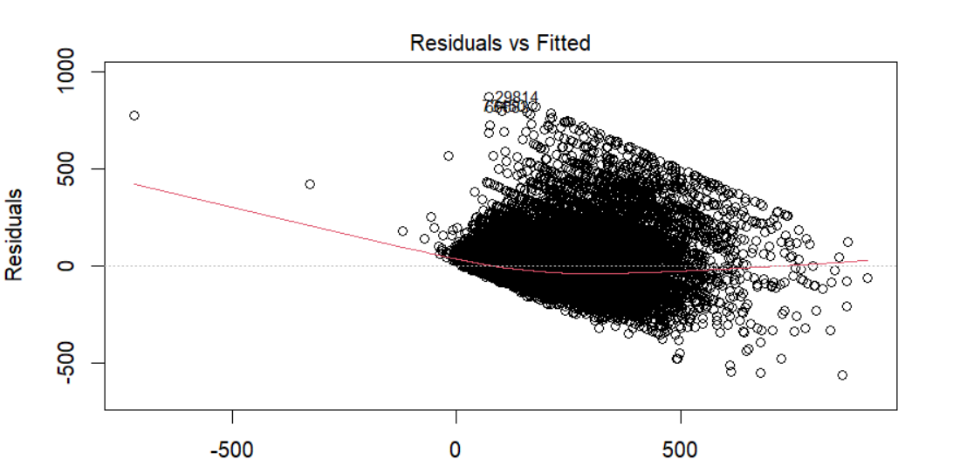
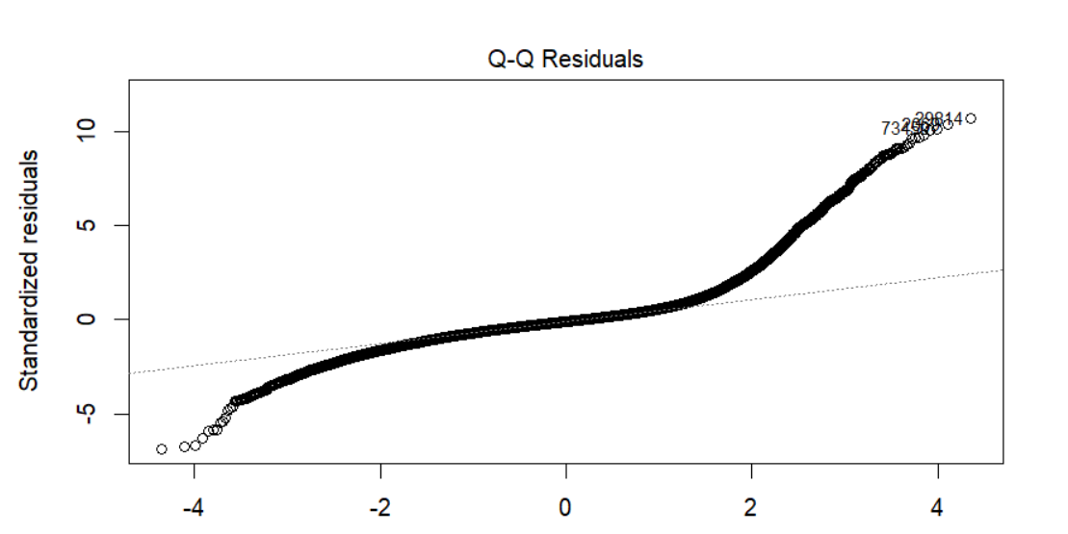
RESIDUAL ANALYSIS
we have graphs for residuals and fitted values from the model. From the Graph we can see that the residuals are surrounded zero, and the residuals are greater with the predicted price increased.
This says that the residuals are following heteroscedasticity. We definitely should overcome heteroscedasticity by either taking log or square of the variables. We did take the squared term for the Price and overcome with heteroscedasticity.

Slide 11
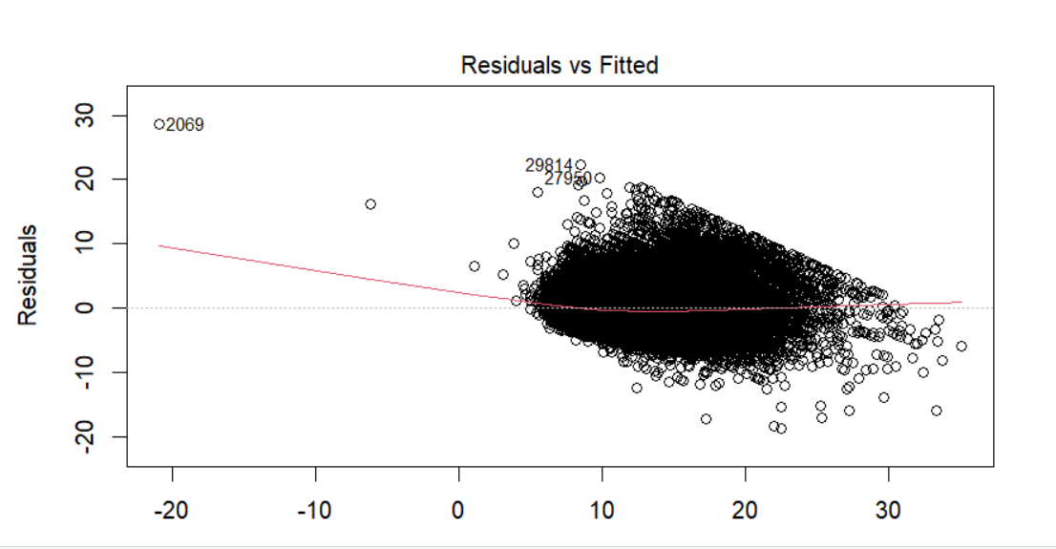
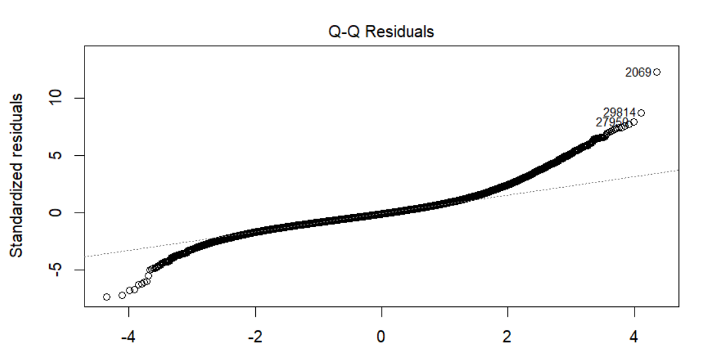
TRANSFORMATION
We have transformed the model to quadratic transformation of the dependable variable
(i.e, Price).
After transforming the dependent variable in the data set, we can clearly see that the residuals are evenly spread and have overcome the variances in residuals just by taking the quadratic of the Dependent variable.
The new Q-Q plot has improved from the previous model by taking the Quadratic term of the Dependent Variable. Thus, we can say that the model is now heteroscedasticity free and have normality in the model.

Slide 12
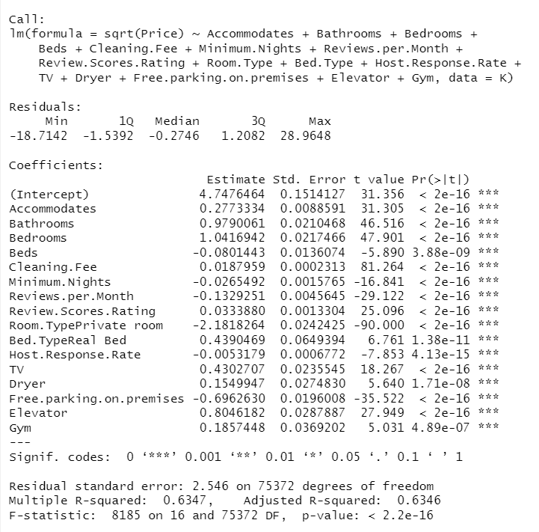
FINAL MODEL
Sqrt (Price) = β0 + βAccommodates ・ x1 + βBathrooms ・ x2 + βBedrooms ・ x3 +
βBeds ・ x4 + βMinimum Nights ・ x5 + βCleaning Fee ・ x6 +
βReviews Per Month ・ x7 + βReview Scores Rating ・x8 +
βRoom Type・ x9+ βBed Type ・ x10 + βHost Respond Rate ・ x11 + βFree Parking on Premises ・ x12 + βTV ・ x13 + βDryer・ x14 + βGym ・ x15 + βElevator ・ x16

Slide 13
04
CONCLUSION

Slide 14
Conclusion
Data Analysis Process: The study started with a comprehensive dataset comprising 88 independent variables, which were then refined to 16 relevant variables for multiple regression analysis. This process likely involved data cleaning and feature selection techniques to ensure the most impactful factors were considered.
Understanding Variables: Through the regression analysis, the researchers gained a deep understanding of both qualitative and quantitative variables influencing Airbnb pricing. This suggests a thorough exploration of various factors affecting accommodation costs, encompassing both tangible (physical attributes like size and amenities) and intangible (review ratings) aspects.
Predictive Capability: The developed model enables users to predict Airbnb accommodation prices by considering all significant variables affecting pricing. This predictive capability empowers users to make informed decisions when selecting accommodations, potentially enhancing their overall experience.
Hedonic Pricing Model: The study suggests the application of a hedonic pricing model due to the inclusion of 16 attribute factors influencing price. This model allows for the valuation of individual attributes contributing to overall pricing, thereby providing insights into the relative importance of different features.

Slide 15
Conclusion
5. City-Specific Variations: The analysis acknowledges the variation in cost of living across different cities, indicating that factors affecting pricing may differ based on location. This recognition of city-specific influences underscores the importance of considering local dynamics when analyzing Airbnb pricing.
6. Key Determinants of Cost: Among the significant factors influencing pricing, the size of accommodations (number of bedrooms, bathrooms, etc.) emerges as crucial, along with factors such as review ratings and amenities like pools or elevators. Understanding these key determinants is essential for comprehending pricing dynamics in the Airbnb market.
7. Future Research Opportunities: The study highlights the potential for further investigation into nuanced differences in how various factors impact pricing across different locations and price points. This suggests a path for future research to deepen understanding and refine predictive models for Airbnb pricing.

Slide 16
Thanks!

